Slide 1

SAF/CAF Fraud Detection and Prevention
Principals’ Meeting
November 8, 2018

Slide 2
Why is Fraud Important?
Association of Certified Fraud Examiners (ACFE) claims that an organization loses 5% of annual revenue to Fraud
District with an operating budget of $500M
Predicted loss to fraud is $25M
What is Fraud:
Any activity that is clandestine, violates the employee’s fiduciary duties to the organization, is committed for the purpose or direct or indirect financial benefits to the employee, and costs the employing organization assets, revenues, or reserves – ACFE
Use of deception by a school district employee for their own personal gain
Notes:
Page 6

Slide 3
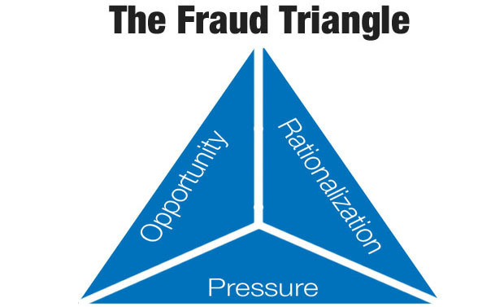
The Fraud Triangle
Provides a Framework to explain why employees commit fraud
Three main components:
Financial Pressure
Perceived Opportunity
Rationalization
Notes:
Page 7: Cressey was an American Criminologist that developed the fraud triangle as a framework to try to explain why employees embezzle money or commit fraud
Financial Pressure Includes:
Large amounts of personal debt
Owning a failing business
Addiction (gambling, alcohol, drugs)
Having an affair
Illness of individual or family member
Maintaining a lifestyle beyond their means
Employee’s perceive this because:
They are in a position of trust
Have knowledge to commit fraudulent acts
Have technical skill to circumvent internal controls
Believe internal controls are weak
Believe management oversight is lacking
Believe they will get away with it
Rationalization may include:
Only borrowing the money
Passed over for promotion
Work overtime without compensation
Have not received a raise
Upper management steals money, why shouldn’t they
This is a punishment to upper management and the organization

Slide 4
One Employee Can Make a Mess
Fraud Detection and Investigation

Slide 5
Club Sponsor
High School teacher and club sponsor
About a 5 year employee with district
Brought a lot of good press to High School
Severe financial problems
3 bankruptcies in 17 years
Tax Liens on rental property owned
Recently divorced

Slide 6

Fraud #1 - Paleta Fundraiser
Club Sponsor had an “Ongoing” Fundraiser for 3 years
Purchased over 8,000 Paletas
Not all at once, 500 or so at a time over 3 years
Had a Freezer installed in her classroom and another teacher’s room
No preauthorization for fundraiser
Sold Paletas at $1 each (should’ve deposited $8K)
Only deposited $2,700
Could not account for $5,300

Slide 7

Missing Paletas – Recommendations
Fundraisers should be Pre-Authorized
Fundraisers should have an End Date
Went on 3 years
Two teachers had freezers installed in their classrooms
Reconciliation at end of Fundraiser
Was it making money?
Were all Paletas or Funds accounted for?

Slide 8
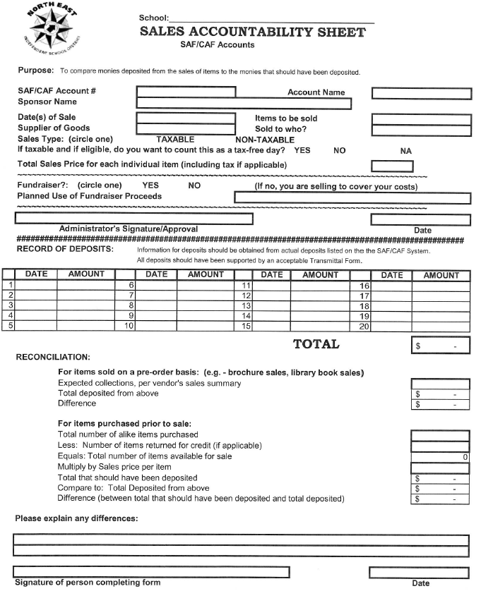

Slide 9
Fraud #2 - Shell Company
Club Sponsor’s son (Joshua) set up a Shell Company
Son was listed as officer/director on Articles of Incorporation
Company did not have any products or provide any services
Sponsor ordered items “Exclusively” with son’s company
High Tech Supplies and Equipment
Laptop Computer
T-Shirts and Polo Shirts
Son then bought items from our usual vendors
Doubled price on items mom purchased
Overcharged the district by $8K

Slide 10
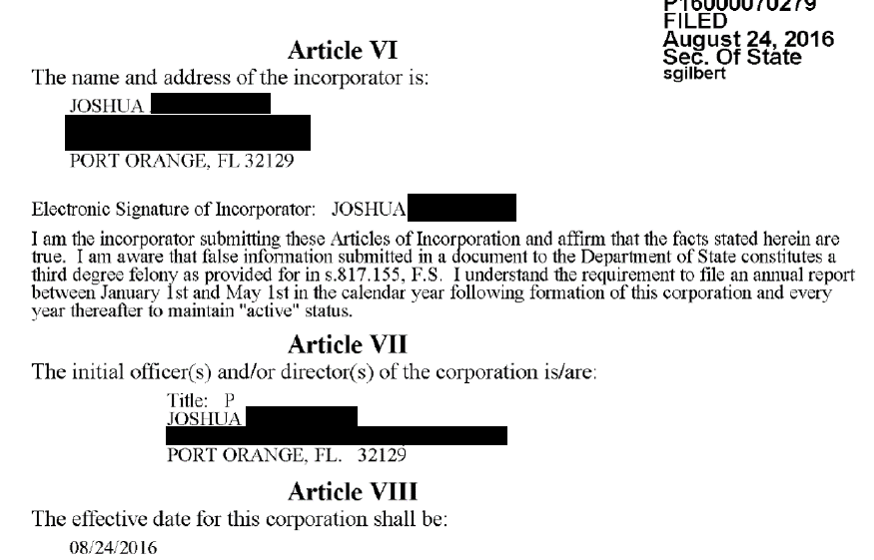
Shell Company Articles of Incorporation

Slide 11
Shell Company – Recommendations
Bookkeeper Should Question use of this Company:
Sponsor uses a new company nobody ever heard of
Uses this company exclusively
Sponsor lobbies others to use this company
Purchases unrelated items from this company
Prices for items double
Bookkeeper should be up to date in scanning to Docuware
Bookkeeper should attend bookkeeper meetings
No administrative should provide oversight on purchases

Slide 12
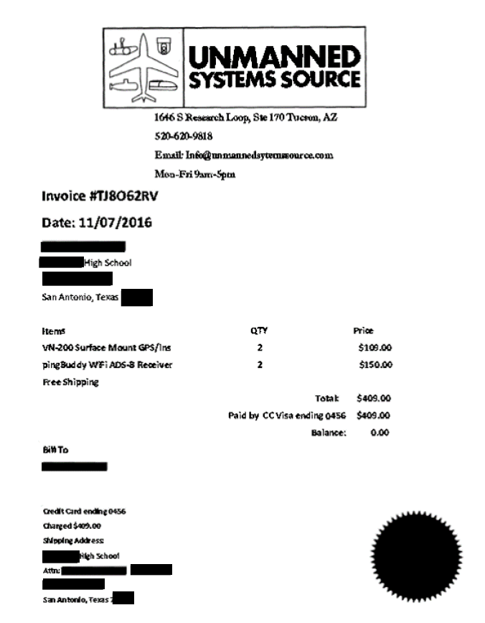
Fraud #3 - Created Fake Invoices
Created 15 Fake Invoices
This is an actual company
Used personal credit card to “purchase” items
No items actually purchased
Handed invoice to bookkeeper
Bookkeeper reimbursed her through SAF/CAF system
Amount totaled over $5K

Slide 13
Fake Invoices – Recommendations
Purchaser must utilize a purchase order
Prohibit use of personal credit cards for sponsor purchases (except in emergency situations)
Bookkeeper should question frequent personal credit card reimbursements
Administrator should provide oversight of personal credit card reimbursements

Slide 14
Fraud #4 -Training Reimbursement Fraud
Sponsor requested to attend 80 hour training class
Class held at local hotel
Was on waiting list and got in to class at last minute
“Had” to pay with personal credit card at the training
Submitted invoice and mileage for reimbursement
Invoice from son’s Shell Company
Submitted a copy of a training certificate as proof of attending
Never attended training, no training took place
Reimbursed $1,550 fraudulently

Slide 15
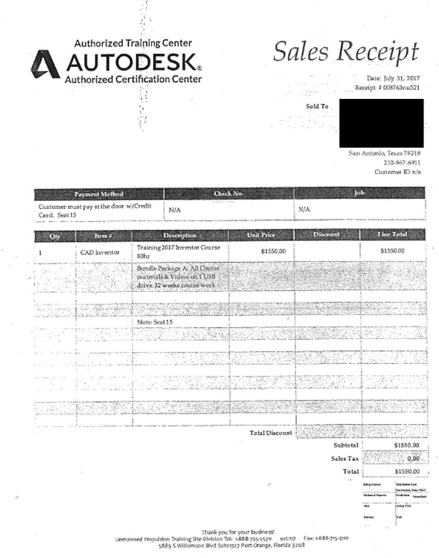
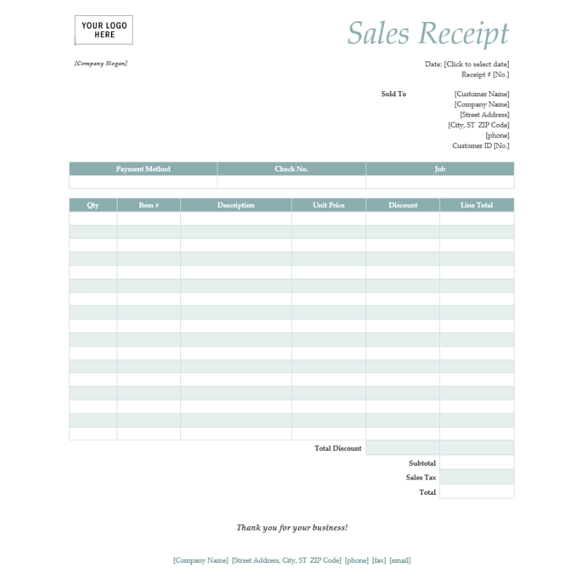
Training Invoice and Blank Template from Sponsor’s Computer

Slide 16
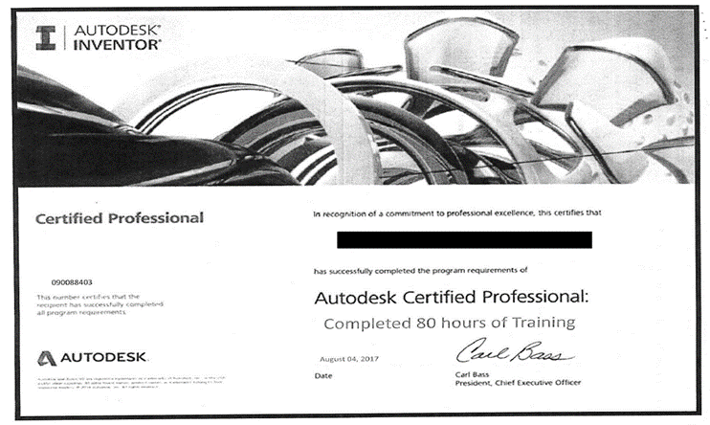
Training Reimbursement Recommendations
Pay for training prior to event (not at door with personal credit card)
Train Bookkeeper to recognize that vendor was suspect
Sponsor should have to provide an original certificate as proof of attending training

Slide 17
Recommendations Overview
Lack of Bookkeeper Oversight
Scan backup documents into Docuware in a timely manner
Attend bookkeeper training
Question purchases that do not look right
Lack of Administrator Oversight
Do not rubber stamp all purchase requests
Preauthorize all Fundraisers
Check up on sponsor’s financial activities
Sponsor’s Ability to Circumvent Internal Controls
Able to initiate, authorize, and receive purchases made with her personal credit card

Slide 18

Contact Information
Dr. Anthony Mitchell, CPA, CFE
Director Internal Audit
amitch@neisd.net
(210) 407-0568

